Slide 1
Are you feeling lost? And No sense of direction?
Well here’s an mobile App for you!

Slide 2
Mobile Path Tracker
Mila, Vercillius
Aranas, Michael

Slide 3
Abstract
An app that tracks the users’ path using the Gyroscope and Compass of an Android device. Its main feature is to record the direction of the path taken by the user and returns a list of directions from where the user stopped to where he started.

Slide 4
Vision and Mission
Vision
To help people who doesn’t have a sense of direction.
Mission
To develop an app that gives users a list of directions to find a way back to where the user started using the app.

Slide 5
Tools and Technologies
IONIC framework
AngularJS
Cordova/PhoneGap platform
W3C Device Orientation Event Specification API.

Slide 6
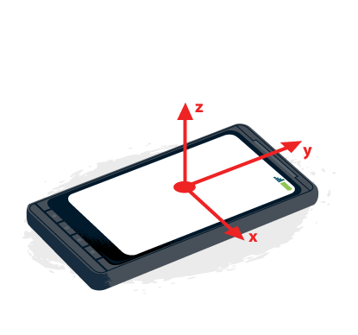
Discussion
Accelerometer

Slide 7
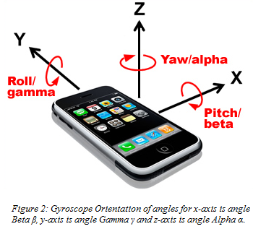
Discussion
Gyroscope

Slide 8
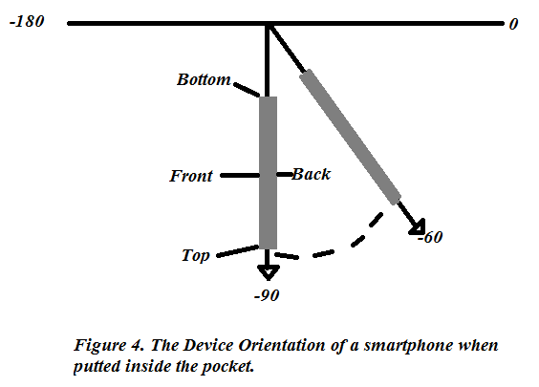
Discussion
Device Orientation of Gyroscope

Slide 9
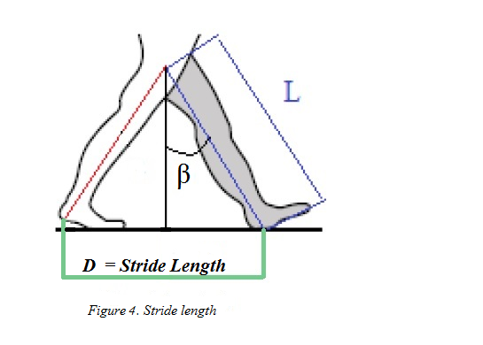
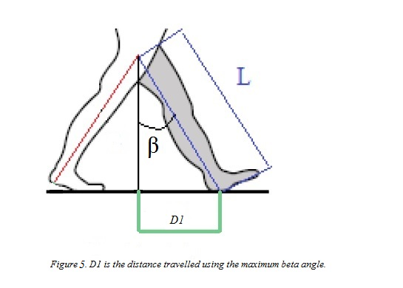
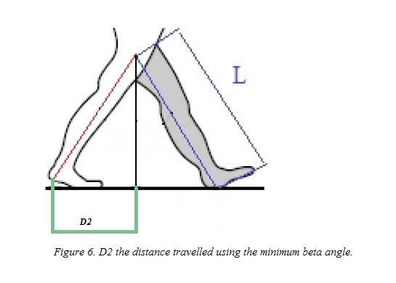
Discussion: First Method Used
Pythagorean Theorem using Gyroscope data
Where:
L – The length of the leg
D₁ – Stride length for maxBeta angle
D₂ – Stride length for minBeta angle
D_{st} – Stride length = D₁ + D₂
β – Angle between adjacent and L (Hypotenuse)
Total D = summation of all D

Slide 10
Discussion: First Method used
sin (min β) = D2 / L (1)
sin (max β) = D1 / L
D2 = sin (max β) x L (2)
D1 = sin (min β) x L
Dst = D1 + D2 (3)
Total Dst = Dst1+Dst2+…+Dstn (4)
Table 1.
Method | Actual distance | Total D_{st} | Accuracy
Pythagorean thereom method | 40 m | 58.34 m | 0.69

Slide 11
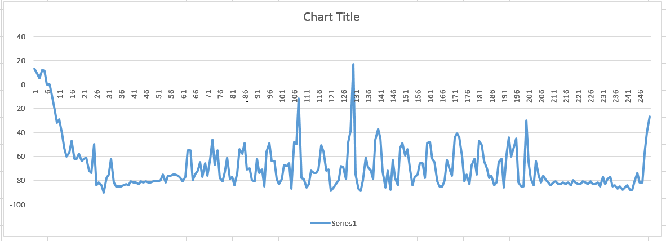
Discussion: First Method used
Error

Slide 12
Discussion: Second Method Used
Stride Length using the height of the user
According to Kate Crosby Co-founder of *WalkingwithAttitude.com a quicker way to estimate stride length is to multiply the height of a person with a constant value but this method is not necessarily accurate.
Men - multiply the height in cm by 0.415
Ladies - multiply the height in cm by 0.413
Ex. To calculate Estimated Stride Length
A lady - 165 cm (height) x 0.413 = 68.145 cm (round off to 68 cm)

Slide 13
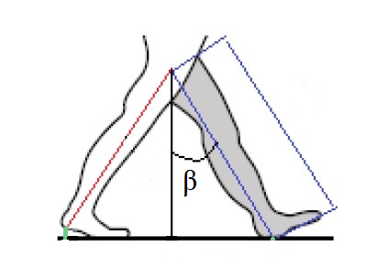
Discussion: Second Method Used
Stride Length using the height of the user
Where,
max β – maximum angle
E.S.L – Estimated Stride Length
T.S.– Total Stride
(# of max β) x (E.S.L) = T.S (4)

Slide 14
Discussion: Second Method Used
Stride Length using the height of the user
Table 2.
Method | Actual Stride (40m) | Calculated Stride (40m) | Accuracy
S.L. Using height method | 14 strides | 21 strides | 0.67

Slide 15
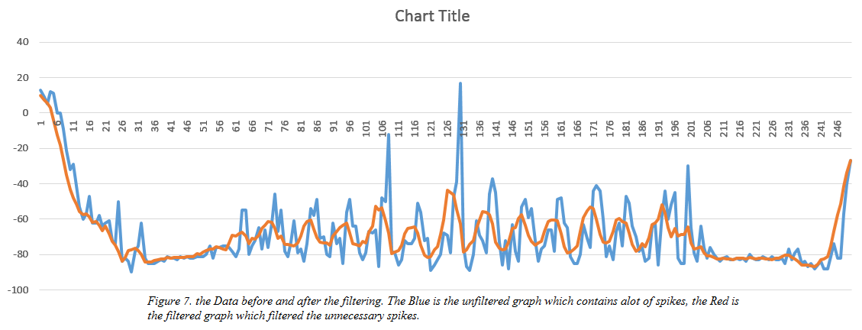
Discussion: Third Method Used
Step Counter using maximum angles from Gyro

Slide 16
Discussion: Third Method Used
Step Counter using filtered maximum angles from Gyro
Table 3.
Method | Actual Stride (40m) | Step Counter (40m) | Accuracy
Step Counter | 14 strides | 15 strides | 0.933

Slide 17
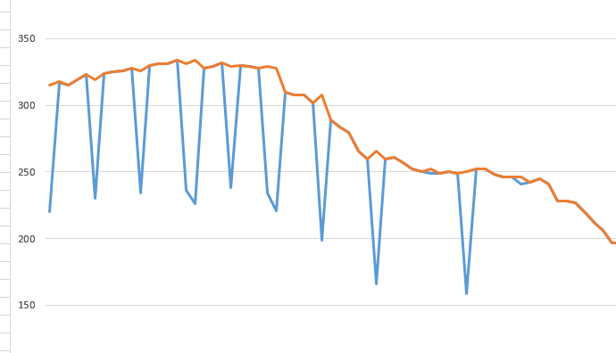
Discussion
Compass filtering

Slide 18
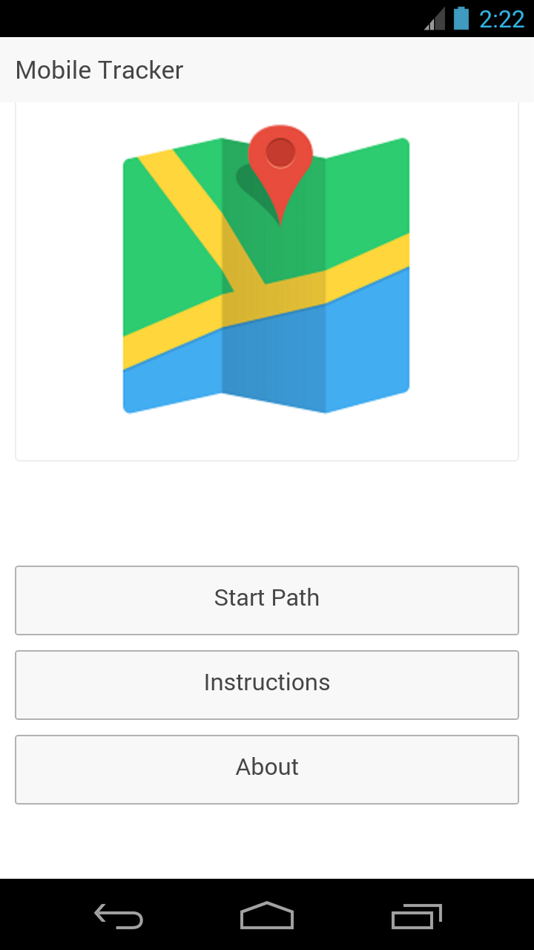
Interfaces

Slide 19
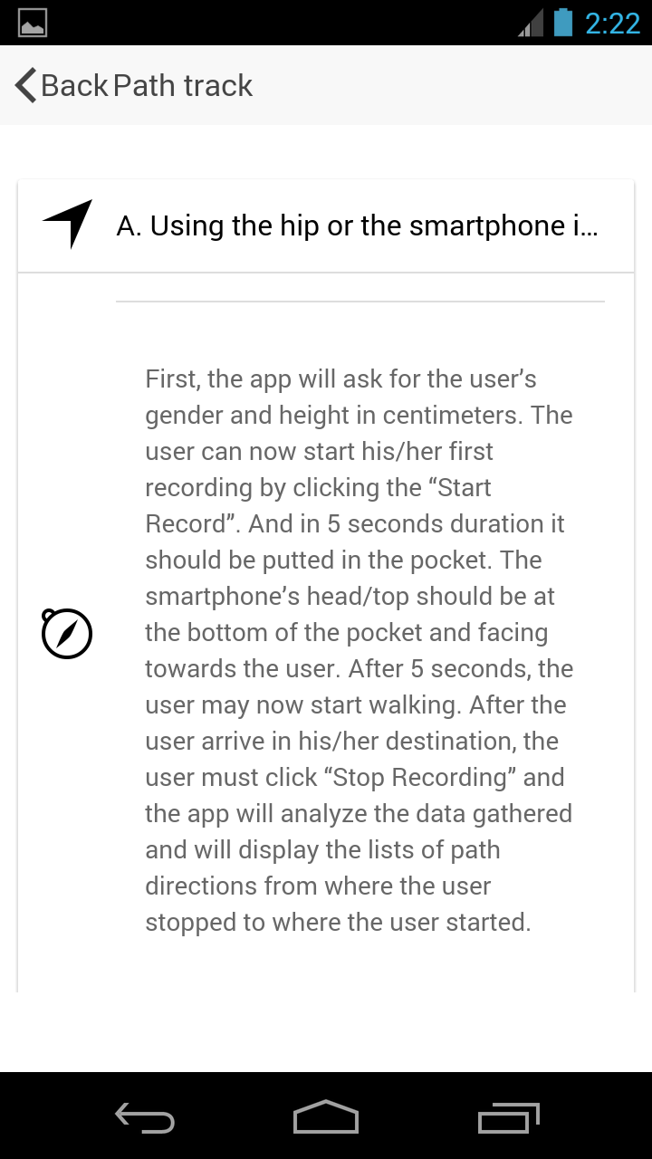
Interfaces: Instruction

Slide 20
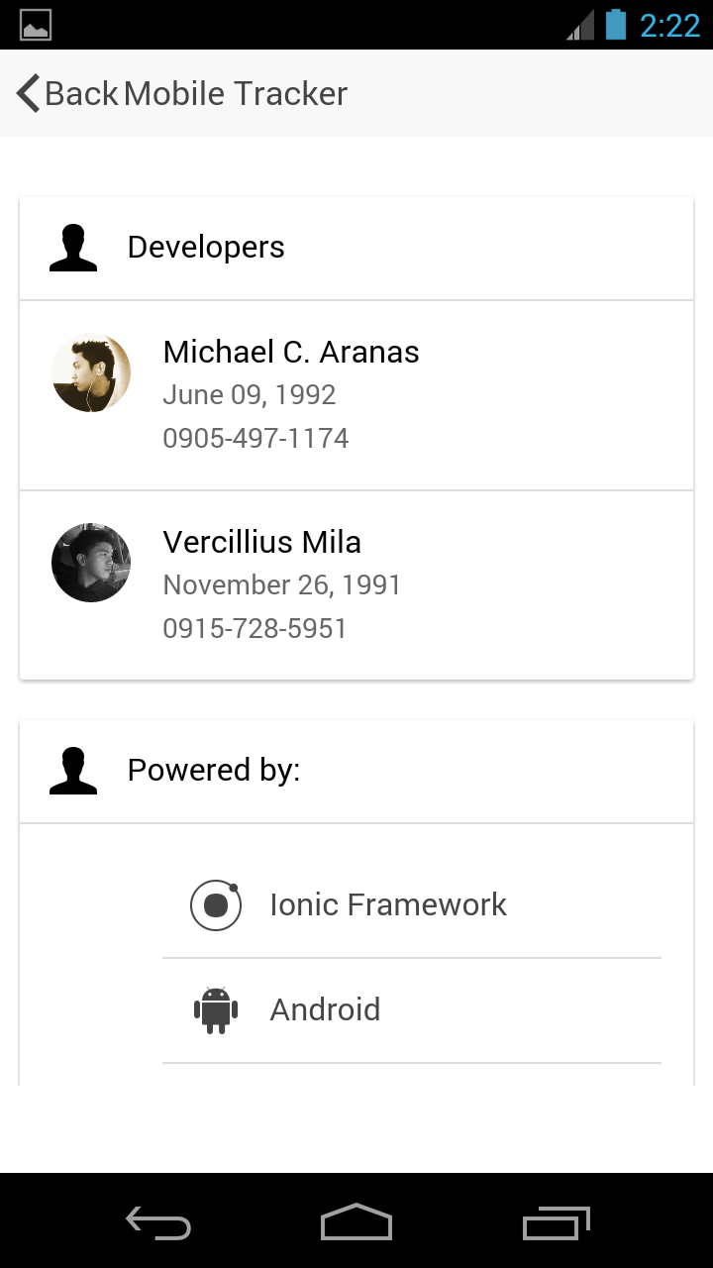
Interfaces: Developer

Slide 21
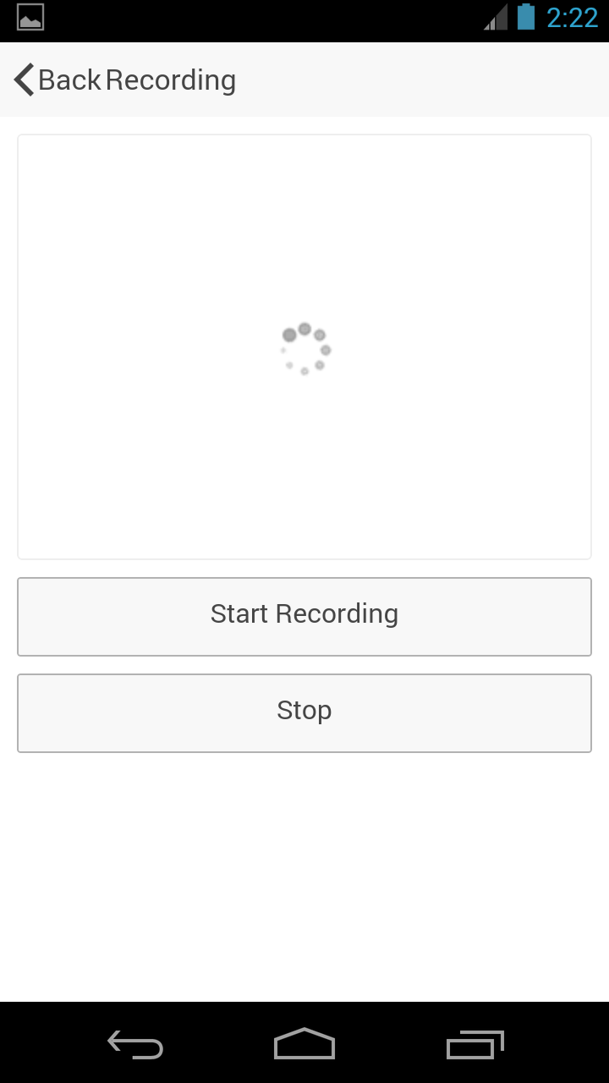
Interfaces: Start Recording

Slide 22
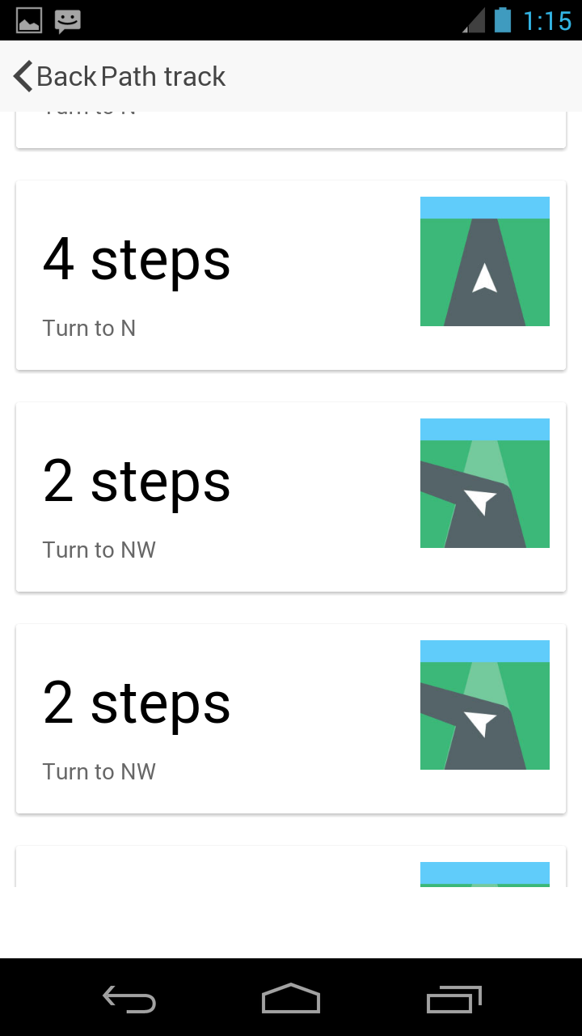
Interfaces: List of Directions

Slide 23
